Slide 1
MIKE 11
Time Series Editor

Slide 2
TIME SERIES EDITOR
Editor and Database of Time Series Data
Network Editor (.nwk11)
Cross Section Editor (.xns11)
Simulation Editor (.sim11)
Boundary Editor (.bnd11)
Parameter Editor (.HD11)
Time Series Editor (.dfs0)

Slide 3
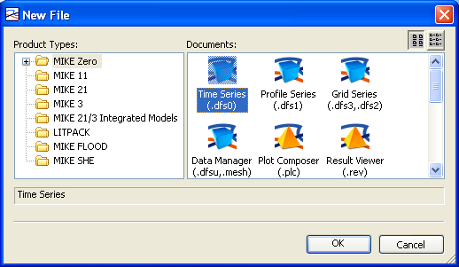
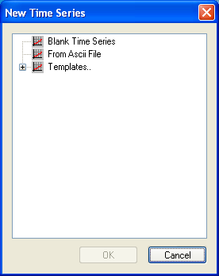
TIME SERIES EDITOR
*.DFS0 File Extension
How? MIKE Zero -> File -> New -> File -> MIKE Zero -> Time Series (.dfs0)

Slide 4
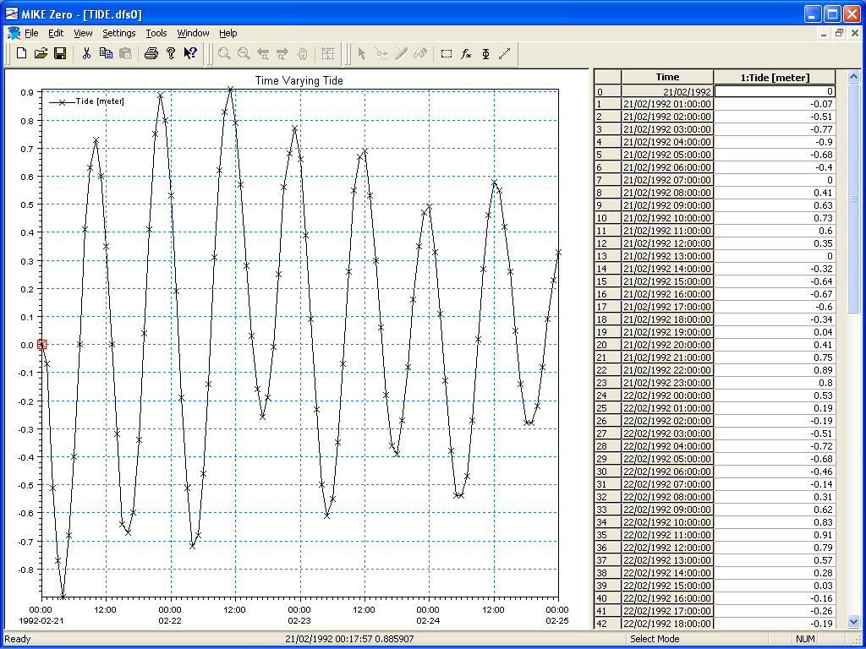
TIME SERIES EDITOR
Graphical and Tabular Views
How? MIKE Zero -> Edit Graphical View -> Right Click
Full Copy/Paste Functionality
Pop up dialog box (right click in Graphical View) Selected points in Tabular View are highlighted in the Graphical View
Select Mode is Default (other modes include Move, Insert & Delete)

Slide 5
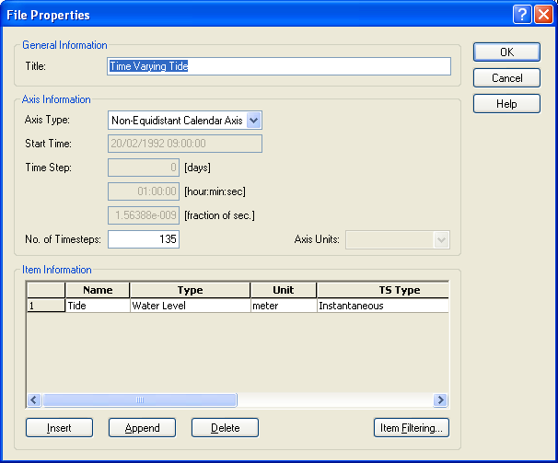
TIME SERIES EDITOR
Edit Menu (Properties)
How? MIKE Zero -> Edit -> Properties, or: Graphical View -> Right Click
Overview of items in the time series file
Change series type and units Insert, Append or Delete time series to and from the DFS file

Slide 6
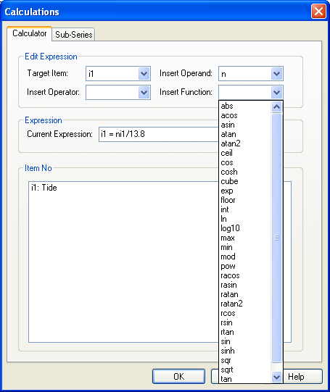
TIME SERIES EDITOR
Tools Menu (Calculator)
How? MIKE Zero -> Tools -> Calculator
Select the time series column number which is to be computed
Insert an Operator, Operand and/or Function Choose previously used expressions

Slide 7
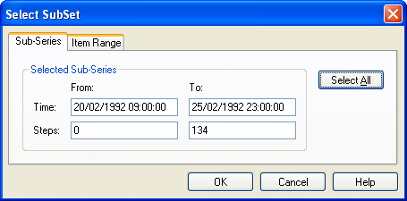
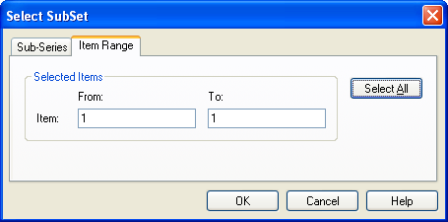
TIME SERIES EDITOR
Tools Menu (Select Sub-Set)
How? MIKE Zero -> Tools -> Select Sub-Set
The calculator supports user defined ranges of time steps and items

Slide 8
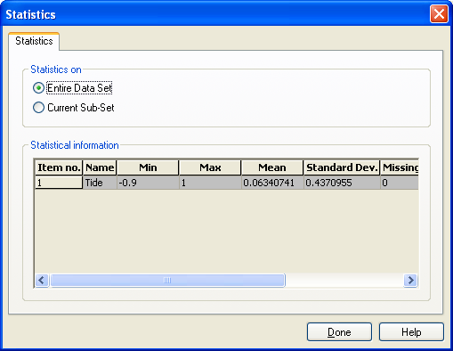
TIME SERIES EDITOR
Tools Menu (Statistics)
How? MIKE Zero -> Tools -> Statistics
Calculate simple statistics for whole or part of time series Min, Max, Mean, Standard Dev., Missing Values

Slide 9
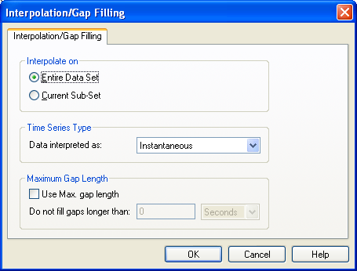
TIME SERIES EDITOR
Tools Menu (Interpolation)
How? MIKE Zero -> Tools -> Interpolation
Use the selected sub-set or the entire period Specify the type of data that is being interpolated
Specify the maximum gap that can be interpolated

Slide 10
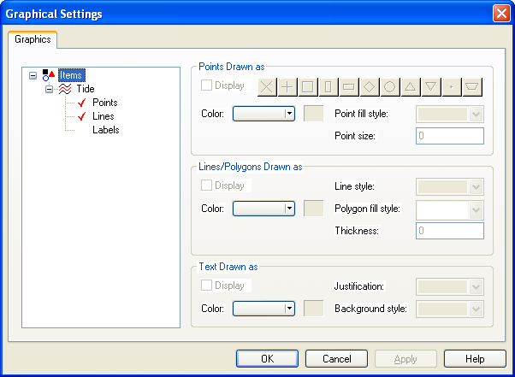
TIME SERIES EDITOR
Settings Menu (Graphics)
How? MIKE Zero -> Settings -> Graphics
Choose the attributes for all graphical objects
Double click the tick marker to display or hide the items on the Graphical View

Slide 11
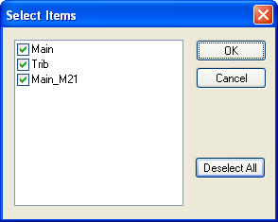
TIME SERIES EDITOR
View Menu (Select Items)
How? MIKE Zero -> View -> Select Items, or Graphical View -> Right Click
Select / Change Items to be Displayed in the Graphical View
Other View Options include Zoom and Pan (Shift-Click)

Slide 12
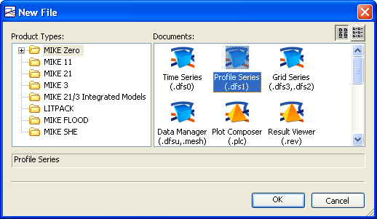
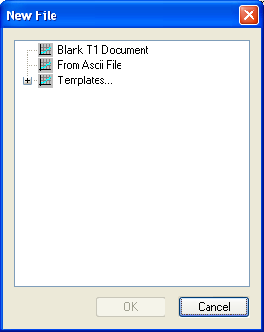
TIME SERIES EDITOR
*.DFS1 File Extension
How? MIKE Zero -> File -> New -> File -> MIKE Zero -> Time Series (.dfs1)

